Slide 1

DATA ANALYTICS PORTFOLIO
RavenStack
SaaS Subscription
& Churn Analysis
Customer Retention Analytics & Revenue Insights
June 2026

Slide 2
PROJECT OVERVIEW
Business Context & Objectives
Business Problem
Project Objectives
RavenStack faces customer churn challenges requiring data-driven insights to guide retention and acquisition strategy across 500 customer accounts.
›
Uncover the drivers of customer churn across segments
›
Evaluate revenue health and LTV by acquisition channel
Identifying churn drivers is critical for sustainable SaaS revenue growth and customer lifetime value optimization.
›
Assess support and product engagement patterns
›
Deliver actionable recommendations for retention strategy
Dataset Scope
Tools Used
500
5,000
25,000
Python
pandas, SQLAlchemy, feature engineering
Customer Accounts
Subscriptions
Usage Events
PostgreSQL / SQL
2,000
600
5
Data modeling, business queries, analysis
Support Tickets
Churn Events
Source Tables
Power BI
Interactive executive dashboard

Slide 3
DATASET & METHODOLOGY
Data Architecture & Pipeline
Source Tables
Data Pipeline
accounts
500 rows, 10 cols
1
Extract
Loaded all tables from PostgreSQL using SQLAlchemy
subscriptions
5,000 rows, 14 cols
2
Transform
Python cleaning, validation, feature engineering
feature_usage
25,000 rows, 8 cols
3
Load
support_tickets
2,000 rows, 9 cols
Customer_metrics table back to PostgreSQL + CSV export
4
Visualize
churn_events
600 rows, 9 cols
Power BI dashboard for executive consumption
Data Quality Assessment
Churn Validation
Date Consistency
Missing Data
Tested churn_flag alignment with subscriptions.end_date — found mismatch, switched to churn_events.churn_date as sole reliable exit signal
Zero violations: no subscriptions starting after end date or before account signup
Satisfaction scores null for 32 accounts (no tickets); feedback_text optional; end_date null for active subscriptions — all handled appropriately

Slide 4
DATA MODELING & ANALYSIS
SQL Analytics & KPI Calculations
Customer Metrics Dataset
Final KPIs
Aggregated all 5 source tables into one analytical row per account with engineered features:
465
months_as_customer
ltv
avg_mrr / avg_arr
Right-censored survival logic
Avg MRR × months as customer
Revenue metrics validated
Total Customers
3.95
Key SQL Analyses Performed
Avg Satisfaction
1.
Churn by Plan Tier — All tiers ~22%
2.
Churn by Referral — Event 30.2% vs Partner 14.6%
16%
3.
Churn Reasons — Features 19%, Support 17.3%
4.
LTV by Channel — Partner $24,965 highest
5.
Upgrade/Downgrade — 20.5% churn post-upgrade
6.
Reactivation — 71% active have churn history
Churn Rate
84%
Retention Rate
$2.30K
Average MRR

Slide 5
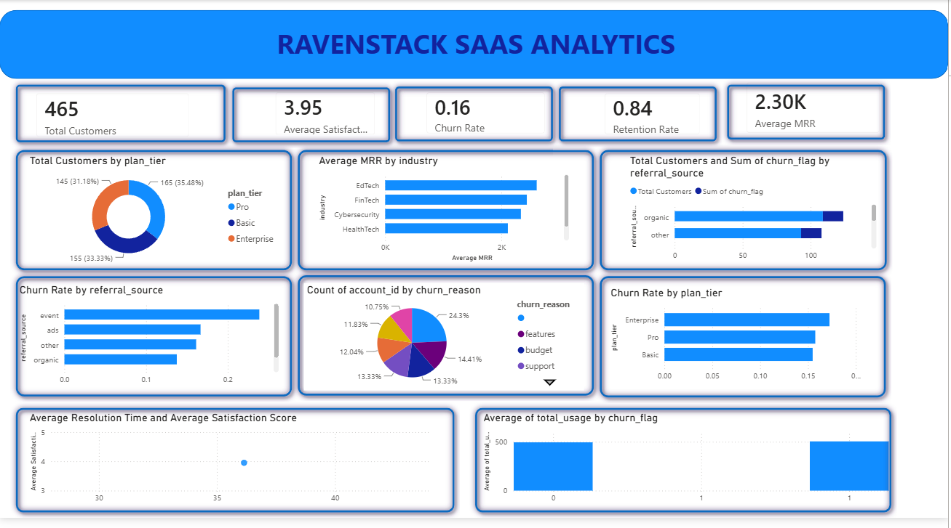
DASHBOARD OVERVIEW
Power BI Executive Dashboard
Dashboard Preview
Interactive
Dashboard Sections
01
Executive KPI Strip — Top-level metrics at a glance
02
Customer & Revenue — Plan mix, MRR by industry, referrals
03
Churn Analysis — Rates by source, reasons, plan tier
04
Customer Success — Resolution time vs. satisfaction
Power BI Dashboard Screenshot
What It Answers
Executive KPI strip, churn analysis, revenue overview, and customer success metrics in a single interactive view
Which acquisition channels retain customers best?
What are the primary drivers of customer churn?
Where is revenue concentrated across segments?
How does support quality correlate with retention?

Slide 6
KEY FINDINGS & RECOMMENDATIONS
Strategic Insights & Actions
Top Insights
Business Recommendations
›
Churn is acquisition-driven, not product-driven
›
Plan tier has minimal impact on churn (~22% each)
1
Reallocate Acquisition Spend
›
Post-upgrade churn signals buyer's remorse (20.5%)
Shift toward partner-sourced channels (14.6% churn vs 30.2% event) with highest LTV ($24,965)
Churn Findings
2
Deprioritize Plan-Tier Retention
Churn is statistically flat across tiers (~22%) — pricing interventions won't move retention
›
Event-sourced: 30.2% churn vs Partner: 14.6%
›
Top reasons: Features 19%, Support 17.3%, Budget 17.3%
3
Investigate Event-Channel Quality
›
32% of churned accounts lack reason codes
Usage and support don't distinguish churners — gap originates at acquisition (lead fit)
Revenue/LTV Findings
4
Address Post-Upgrade Churn
›
Partner referral delivers highest LTV: $24,965
20.5% churn after upgrade vs 8.8% after downgrade — buyer's remorse needs customer success attention
›
Churn flat across all plan tiers (~22%)
5
Close Churn-Event Data Gap
32% of churned accounts lack reason codes — improving capture is an operational priority

Slide 7

CONCLUSION
Project Outcome & Impact
Project Outcome
Key Learnings
Delivered actionable insights identifying acquisition channel quality as the primary churn driver, enabling targeted retention strategy and resource reallocation.
›
Churn events table is the most reliable exit signal — flags can mislead
›
71% of active accounts have prior churn history — reactivation tracking is critical
›
Data completeness matters — 32% missing churn reasons limits diagnosis
Skills Demonstrated
›
End-to-end analytics pipeline — Python ETL, SQL analysis, Power BI
Business Impact
›
Data quality validation — Identified churn_flag mismatch
$4,689
15.6%
›
Feature engineering — Survival-based tenure, LTV calculations
›
Business-focused recommendations — Channel strategy insights
LTV Difference (Best vs Worst Channel)
Churn Rate Gap (Event vs Partner)
Recommended shift from plan-tier to acquisition-quality interventions, enabling RavenStack to focus retention investments where they matter most.
Thank you for your attention

